Slide 1
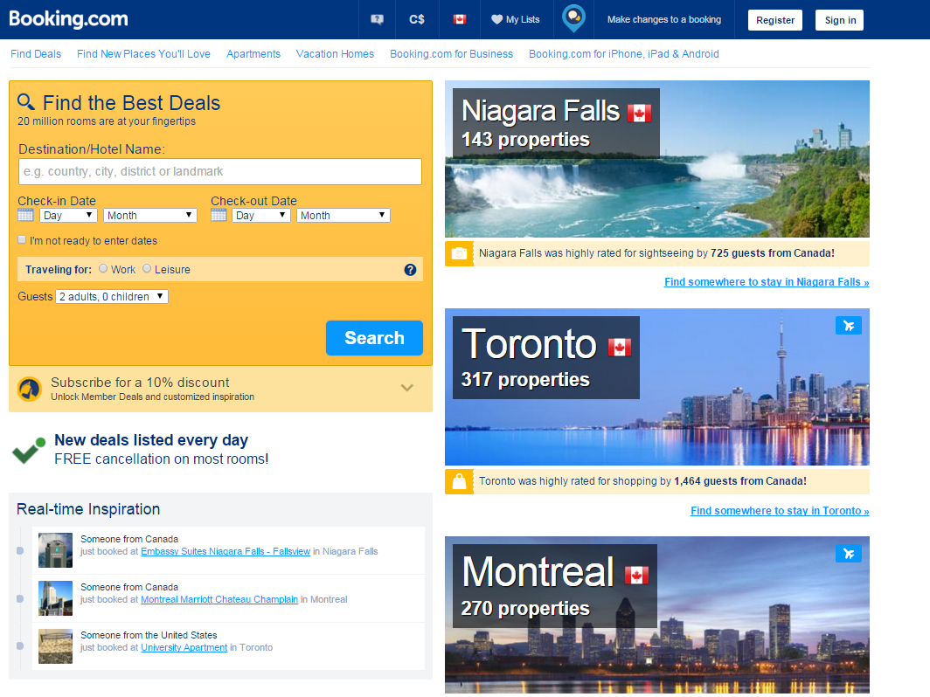
Consider the problem of getting more people to subscribe to the booking.com mailing list.
This is a screenshot of the current site.

Slide 2
This “B” variation was made using just PowerPoint.
Steps:
Import image into slide
Put white box over the area to re-layout
Import image again, use image crop tool on ribbon to crop to just the “Subscribe” box
Import image again, crop to just the “Find the best deals” box
Arrange two component images in opposite order than before, leaving whitespace
Create a rectangle over the old “subscribe” text, use the eyedropper tool in the fill color dropdown to match the image color.
Add new text, resize, and recolor it
Feel free to pull apart the components to better understand what was done!
Subscribe to save 10% today!

